Slide 1
IS7012 Final Project
Bearcat Sports Buyback
Neil Bechmann
Jessie Beyrer
Jameson Zink

Slide 2


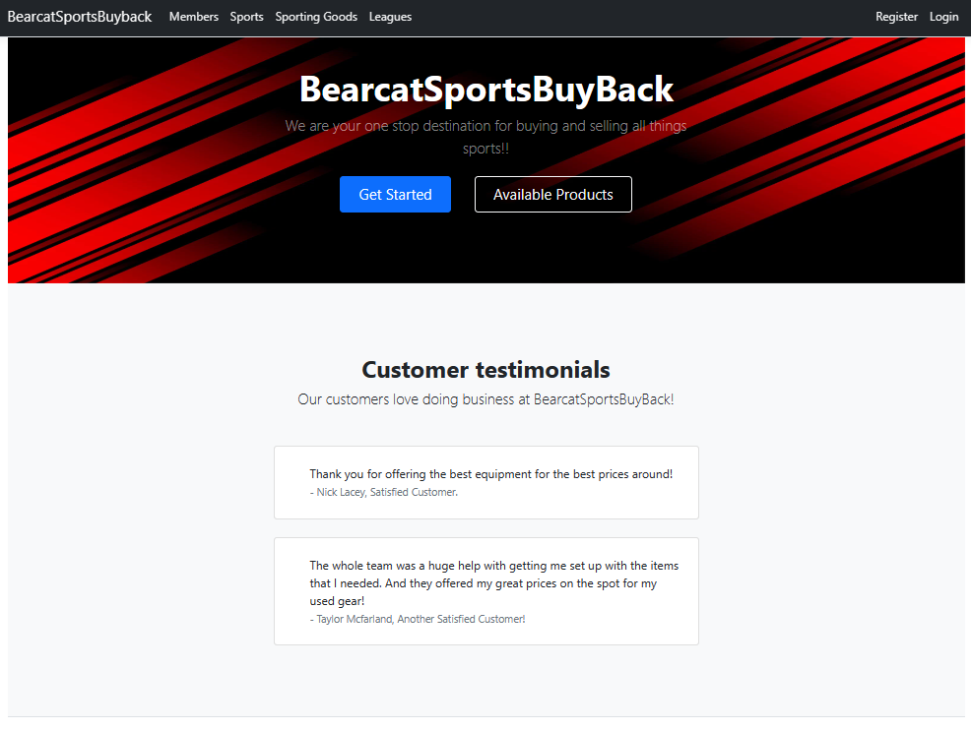
Quick Demonstration
BearcatSportsBuyback GitHub Link

Slide 3
Errors or bugs
"Interest in Joining a League" is a Boolean field that we struggled to get populated correctly with a Yes/No response that could be utilized as usable field and search field.
For the Search Page the SportId and LeagueId were not allowing a name change on OnGetSync() when trying to change it. Visual Studio told us we could not have multiple OnGetSync() on Search page.
For Style on the Registration Page, we were unable to remove the "Use another service to register" portion of the page.

Slide 4
additional time Enhancements?
More in depth classes with more class relationships would have been nice to add to give more detail in the project and site.
A more robust statistics page that could deliver more usage and cumulative class details for that particular page.
Stylistically, it is not clear that we have products available for sale/resale on our site additional lessons on creating a card view rather than list view would be helpful in setting up a sales type website.

